Slide 1
Rheumatic Fever: Current Status
Dr Jaganmohan A Tharakan
Professor of Cardiology
SCTIMST, Trivandrum

Slide 2
Rheumatic Fever: Current Status
Epidemiology
Streptococcal Infection and link to ARF
Pathological and morphological lesions
Evolution of Guidelines for diagnosing ARF
Treatment strategy
Secondary prophylaxis: extension to population at risk
Vaccines

Slide 3
Epidemiology of group A streptococci, rheumatic fever and rheumatic heart disease
Rheumatic fever (RF) and rheumatic heart disease (RHD) are Non-suppurative complications of Group A streptococcal pharyngitis due to a delayed immune response.
Although RF and RHD are rare in developed countries, they are still major public health problems among children and young adults in developing countries.
The economic effects of the disability and premature death caused by these diseases are felt at both the individual and national levels through higher direct and indirect health-care costs.

Slide 4
Acute Rheumatic Fever : Epidemiology
Developed countries
Less developed countries
Incidence decreasing <2/10⁵
Prevalence: In Epidemics
Sub populations : ethnic/ low socio economic strata/ marginalized
  Mauri tribes in NZ, indigenous population in Australia (150-300/10⁵⁾
ARF Criteria: should be stringent( specific) in low risk population
Incidence high: >100/10⁵
Prevalence: endemic
Geographic variation
Criteria should be less stringent( more sensitive) in high risk population

Slide 5
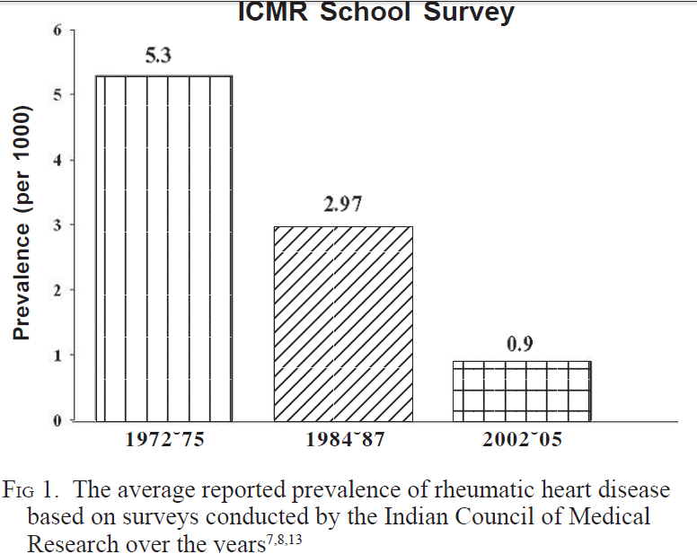

Slide 6
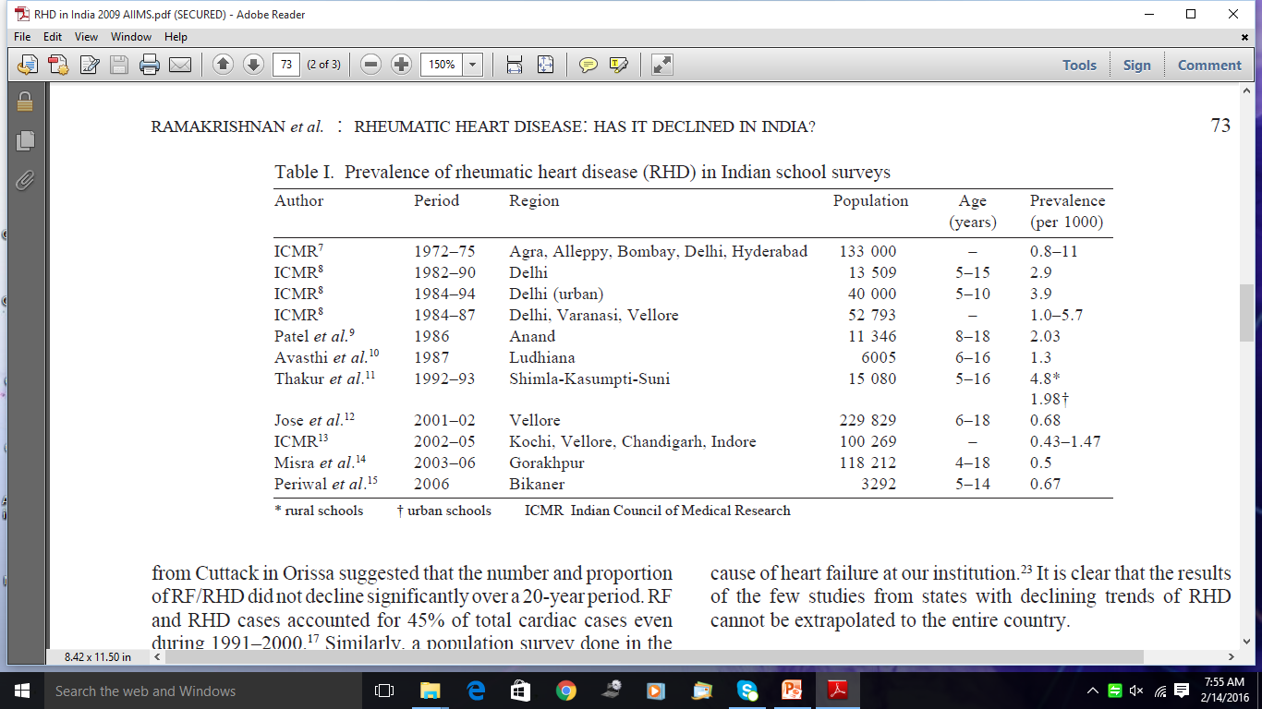

Slide 7
ARF: Preceding Streptococcal infection
As Str. Sore throat precedes ARF by at least 2 weeks
Str. Sore throat may be missed
Str. Sore throat with rheumatogenic strains in the community/ school/ army camps should alert one to ARF(ARF incidence as high as 3%)
Str. Infection often needs serology as throat culture may be sterile/ residency without infection(carrier).
Carrier state is not associated with risk of ARF in absence of infection

Slide 8
ARF: Susceptibility
Host Factors
Racial characteristics: Maoris in NZ, Samoans in Hawai, pacific Islanders, indeginous pop. in Australia
Familial/ genetic susceptibility: HLA DR3, DR4, DQw2, B cell alloantigen D8/17
Individual variability in antibody response to the GABHS infection
Past H/O ARF
Age group 5-15 years

Slide 9
ARF: Susceptibility
Attributes of GABHS
GABHS M serotypes 1,3,5,6,14,18,19,24,27,29
  Not associated with M 2,4,28
Only throat infection/ pharyngitis
Strains rich in M protein induce marked immune response and probably share epitopes with human tissue
Recently, mucoid producing strains were found to be more rheumatogenic

Slide 10
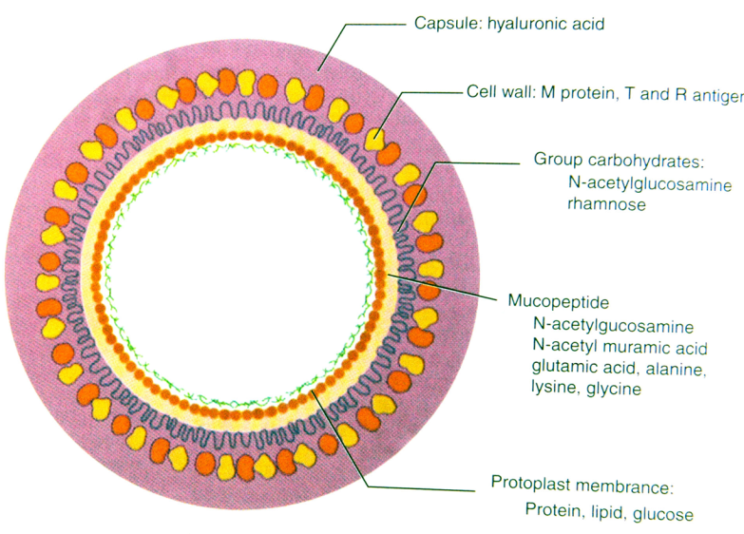
Group A Streptococci: Cell wall Components of Clinical Interest
Capsule: Hyaluronic Acid: Non antigenic
Cell Wall:
  Surface Protein:
    M protein: Type Specific Antigen: Virulence factor
  Group A carbohydrate: N acetyl glucosamine+ Rhamnose: Group specific antigen: Lancefield classification
Mucopeptides: common to many bacteriae
  N Acetyl glucosamine
  N Acetyl muramic acid

Slide 11
Group A streptococcal Antigens & Antibody titres
Streptolysin O: Anti streptolysin O
DNAse B: Anti DNAse B
Streptokinase: Antistreptokinase
Nicotinamide Adenine Dinucleotidas: Anti NAD
Group Specific polysaccharide; anti strept. Polysaccharide
Cell wall associated M-protein: Anti M-protein antibody

Slide 12
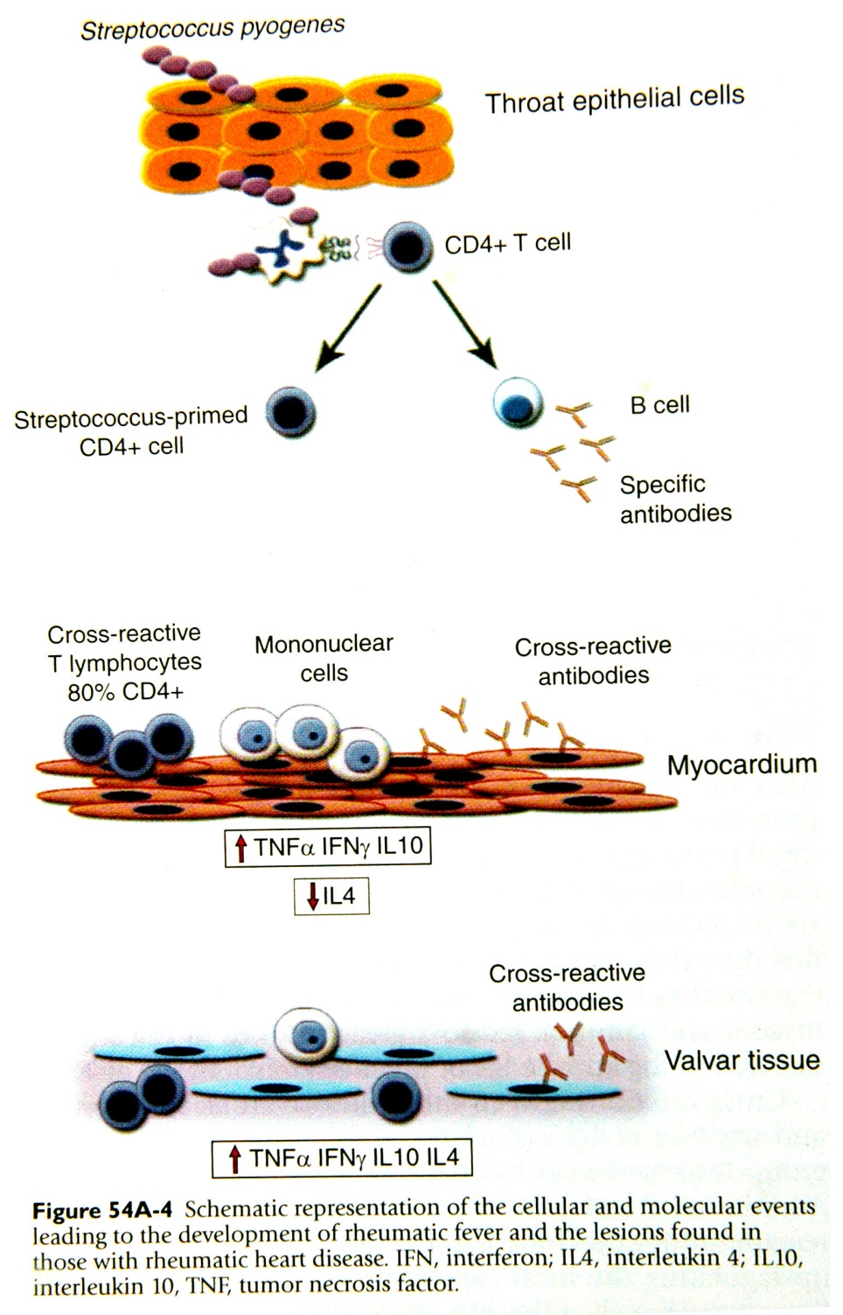

Slide 13
Diagnosis of GABHS pharyngitis
Suggest GABHS
Suggests viral
Sudden onset sore throat
Pain on swallowing
Fever
Tonsillo pharyngeal exudates
Soft palate petechiae
Red swollen Uvula
Tender anterior cervical nodes
Conjunctivitis
Coryza
Hoarseness, cough
Diarrhoea
Characteristic exanthems

Slide 14
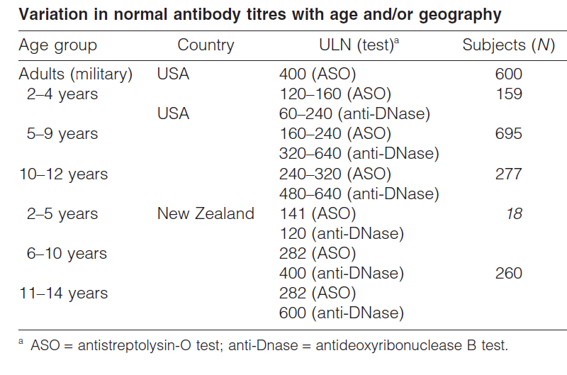

Slide 15
Mechanism of Valve Damage
Antigens, which are recognized as foreign by the
susceptible host, induce a hyperactive humoral and cellular immune response that damages native tissues bearing similar antigen.
Antibodies to the N-acetyl-glucosamine moiety of group A polysaccharide
cross-react with the heart valve tissue

Slide 16
Pathology of Human Tissue Involvement
Skin, synovium, brain:
  Inflammation is self limiting and heal without residua
  Edema, inflammation and infiltration with predominant lymphocytes, few neutrophils.
  Perivascular inflammatory lesions
  Subcutaneous nodules have central fibrinoid necrosis surrounded by inflammatory reaction

Slide 17
Cardiac Involvement
The histopathologic findings in myocardium include the “pathognomonic” Aschoff nodule
  The Aschoff granuloma consists of a central area of fibrinoid necrosis surrounded by cells of histiocytic macrophage origin (Anitschkow cells), which show a typical owl’s eye–shaped nucleus.
  These cells are usually found in the subendocardial or perivascular regions in the myocardium.
Little histopathologic damage to the myocardium, even in patients with florid clinical carditis and heart failure.
Myocyte necrosis is uncommon, and the cellular infiltrate is confined to the interstitium.
This correlates with the lack of troponin leaks even in patients
with frank rheumatic myocarditis.
Progresses from exudative phase to fibrotic phase over 6 months
Is not a useful marker for active carditis

Slide 18
Valve Involvement
Valves bear the brunt of the inflammatory reaction: Mitral/ aortic/ tricuspid in that order
Typical lesions:
  Small Sterile vegetations or verrucae over the edges of the leaflets, do not cause thrombo embolism.
  Sub valvular apparatus and valve annulus also involved

Slide 19
Notes:
Valvulitis. (A) Gross appearance of the mitral valve
shows characteristic tiny, wartlike verrucae or vegetations on its
inflow side (atrial surface). (B) Similar verrucae on the ventricular
surface of the aortic valve. The verrucae are sterile and small and
only rarely result in embolization (unlike vegetations of bacterial
endocarditis). (C) Microscopic appearance

Slide 20
Notes:
(A) Low-power microscopic intramyocardial view
shows Aschoff bodies. Note the nodular aggregate of Aschoff cells
immediately adjacent to a coronary arteriole (Hematoxylin and
eosin, ×120). (B,C) High-power microscopic view of an Aschoff body
illustrates the characteristic “owl-and-caterpillar” nuclei

Slide 21
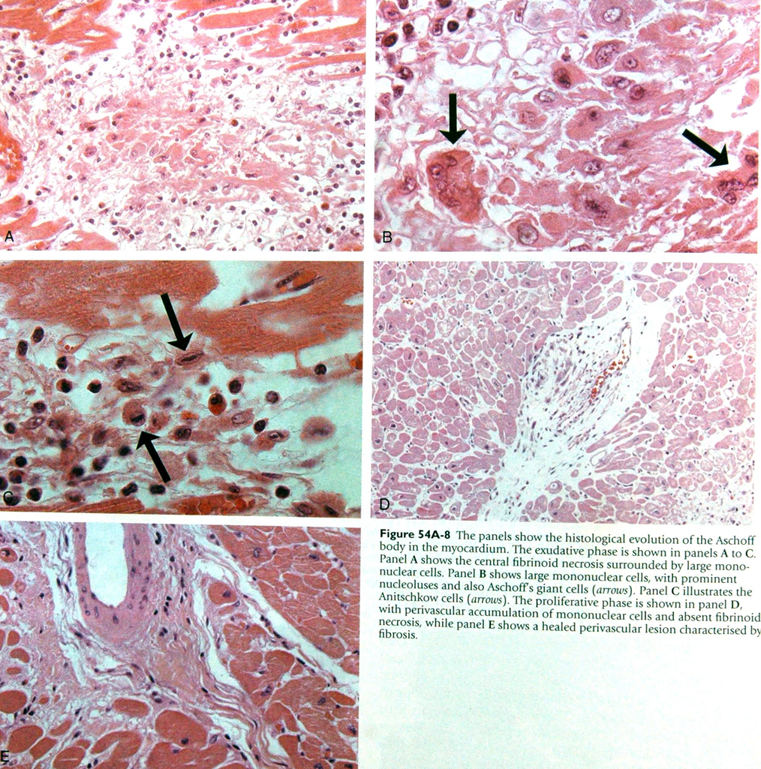

Slide 24
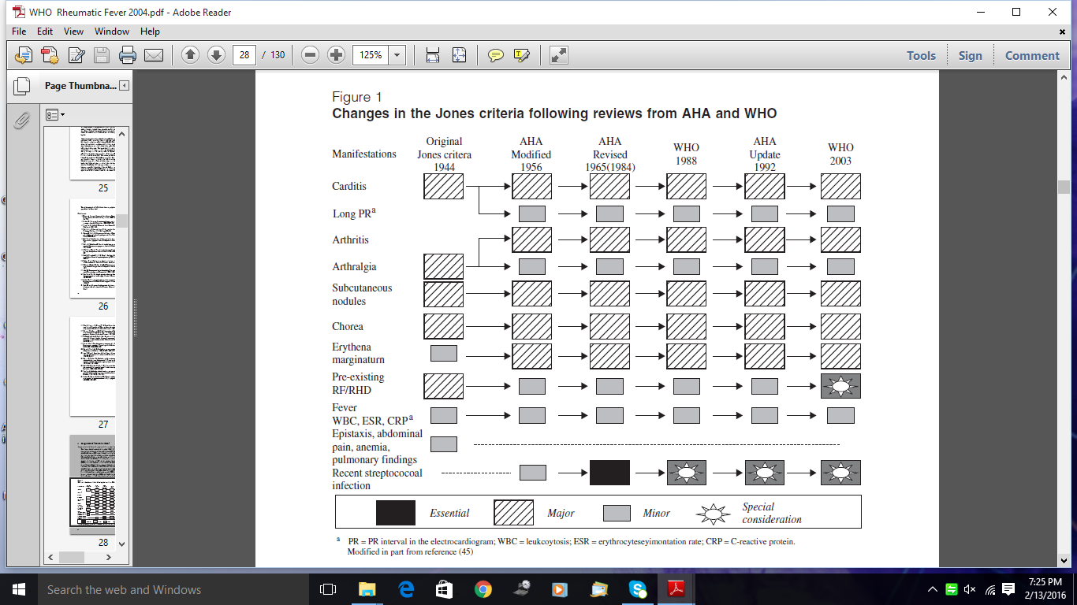
Notes:
ARF in pts with RHD: difficult to diagnose carditis in view of pre existing valve disease and new onset murmurs/ worsening regurgitation lesions not reliably assessed.

Slide 25
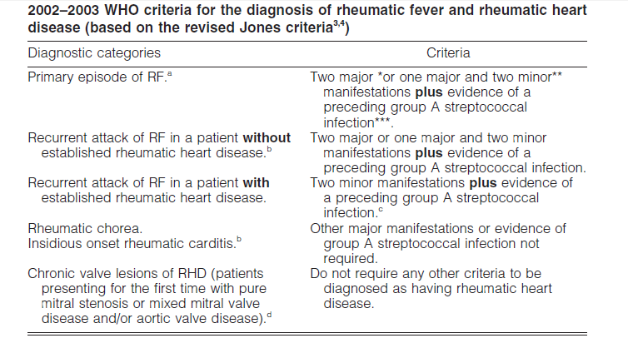

Slide 26
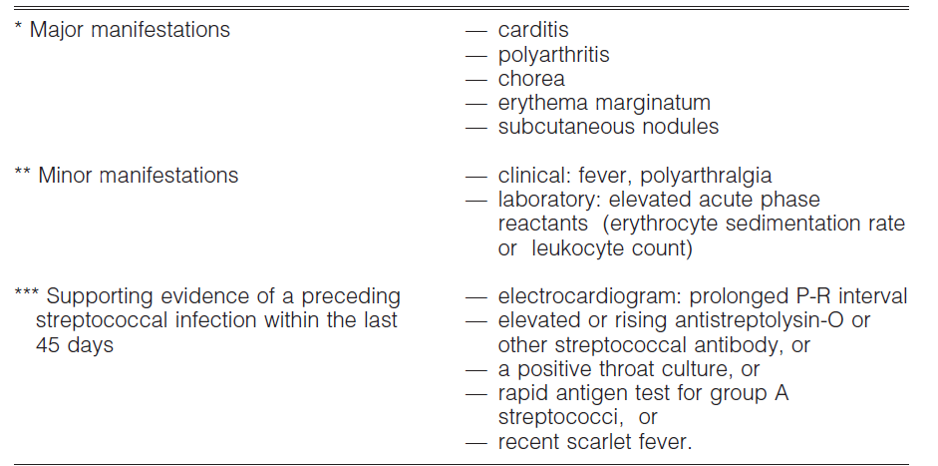
WHO 2002

Slide 27
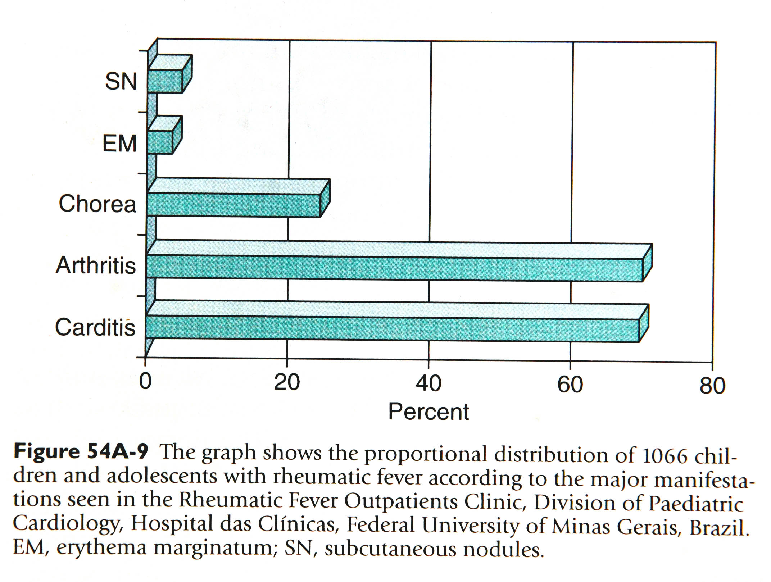

Slide 28
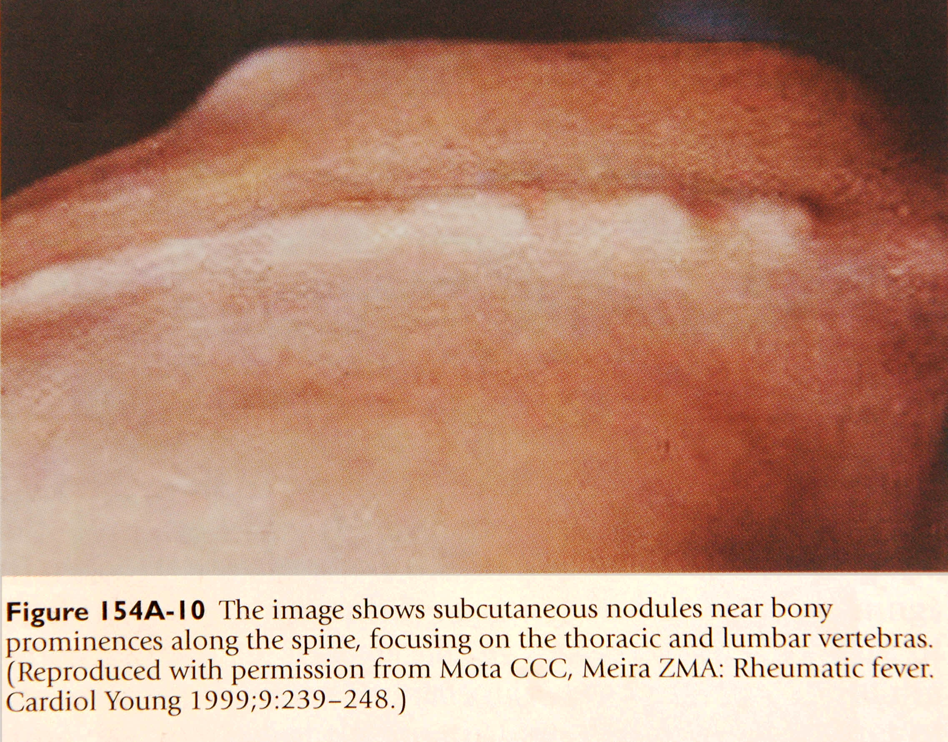

Slide 29
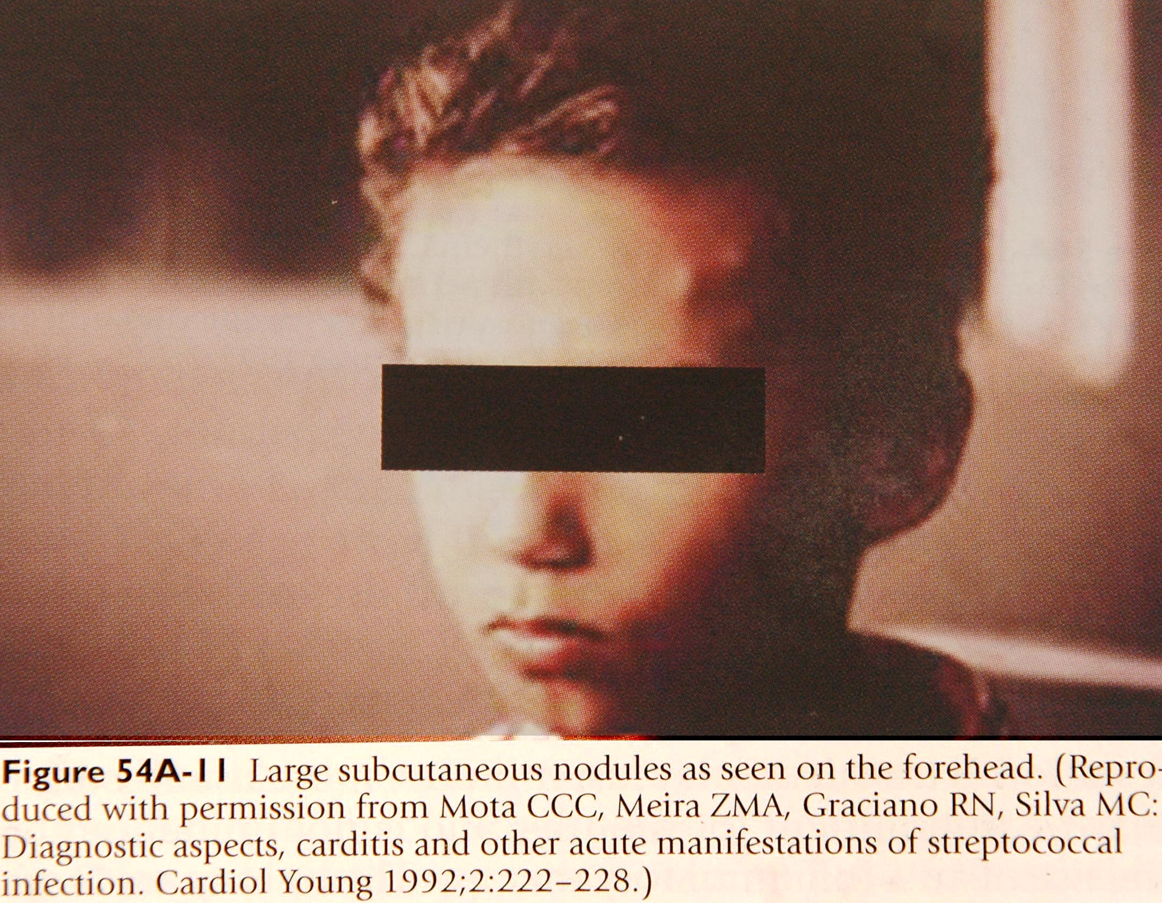

Slide 30
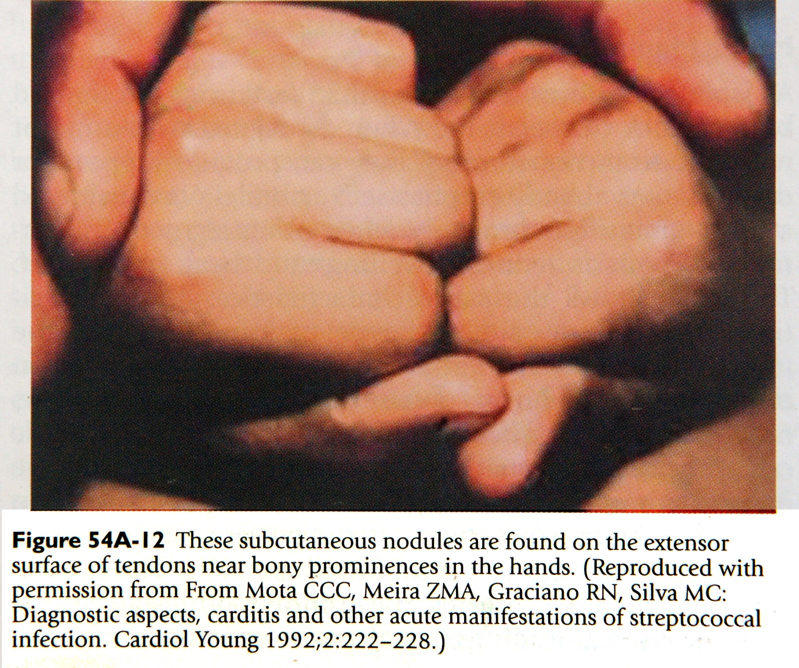

Slide 31
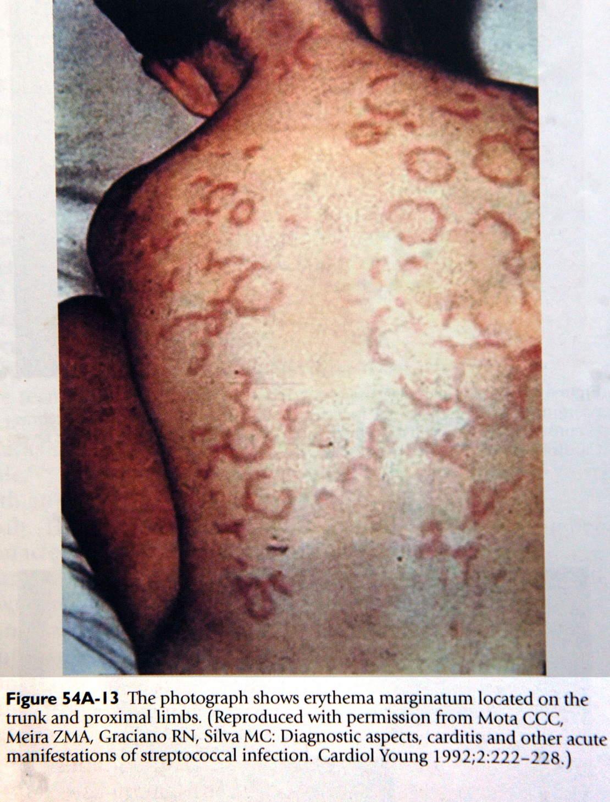

Slide 32
Electrocardiographic Changes:
PR prolongation most common: 30%
No association with other carditis features and equally present in both isolated arthritis and carditis
Does not predict long term sequelae in absence of clinical valvulitis
Consensus: Non specific change with same significance like acute phase reactants
Other AV conduction abnormalities and AV dissociation less common

Slide 33
Resurgence of RF in US:1985-1995: 327 cases: some highlights
Acute pharyngitis requiring treatment was reported in a minority
Rheumatogenic strains were mucoid producing and more virulent in causing ARF( M3, M18)
Antecedent Strept. infection was confirmed by elevated anti streptococcal antibodies in all cases
ARF occurred in a small % of pts. treated for 10 days with appropriate oral antibiotics

Slide 34
Resurgence of RF in US: Clinical: 327 cases
Major Manifestation
No of pts. (%)
Single major
  Carditis
  Arthritis
  Chorea
Two major
  Carditis with arthrits
    Erythema marg
    Subcut. Nodules
  Carditis with Chorea
  Artritis with Erythema marg
60%
  27%
  12%
  19%
40%
  25%
    3%
    2%
  15%
  3%

Slide 35
Resurgence of RF in US:1985-1995
Role of Echo Doppler
Use of Echo Doppler increased the pick up of carditis not detected as murmur by clinical examination
Useful especially when pts present with only polyarthritis/ chorea as the only major manifestation
Confirms carditis and need for extended rheumatic fever prophylaxis

Slide 36
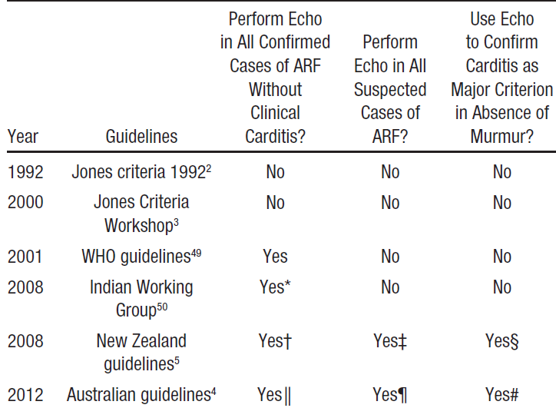
Role of Echo Doppler in diagnosis of Rheumatic Fever
Notes:
WHO guidelines: The issue with ARF is many patiens with ARF do not have arthritis and hence both mild clinical and subclinical carditis will be missed major clinical symptoms, and will not benefit from long term penicillin prophylaxis. Australian and NZ guidelines recommend echo in suspected ARF.
Not to miss ARF without

Slide 37
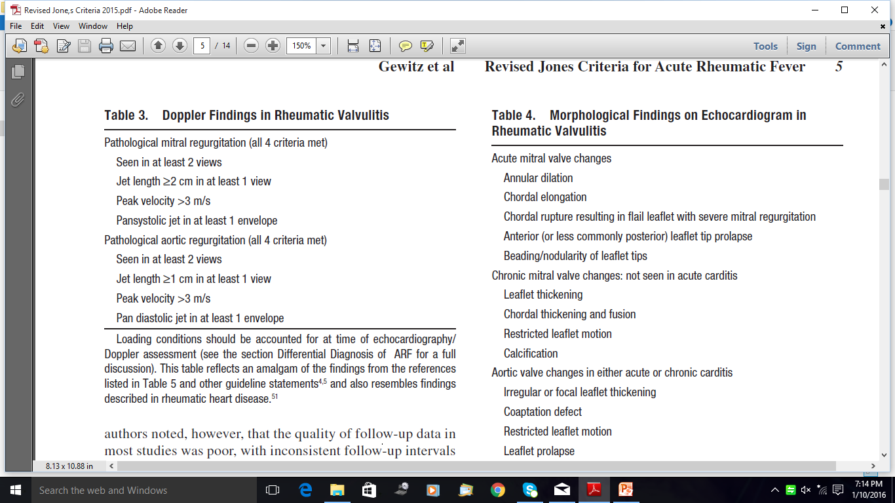

Slide 38
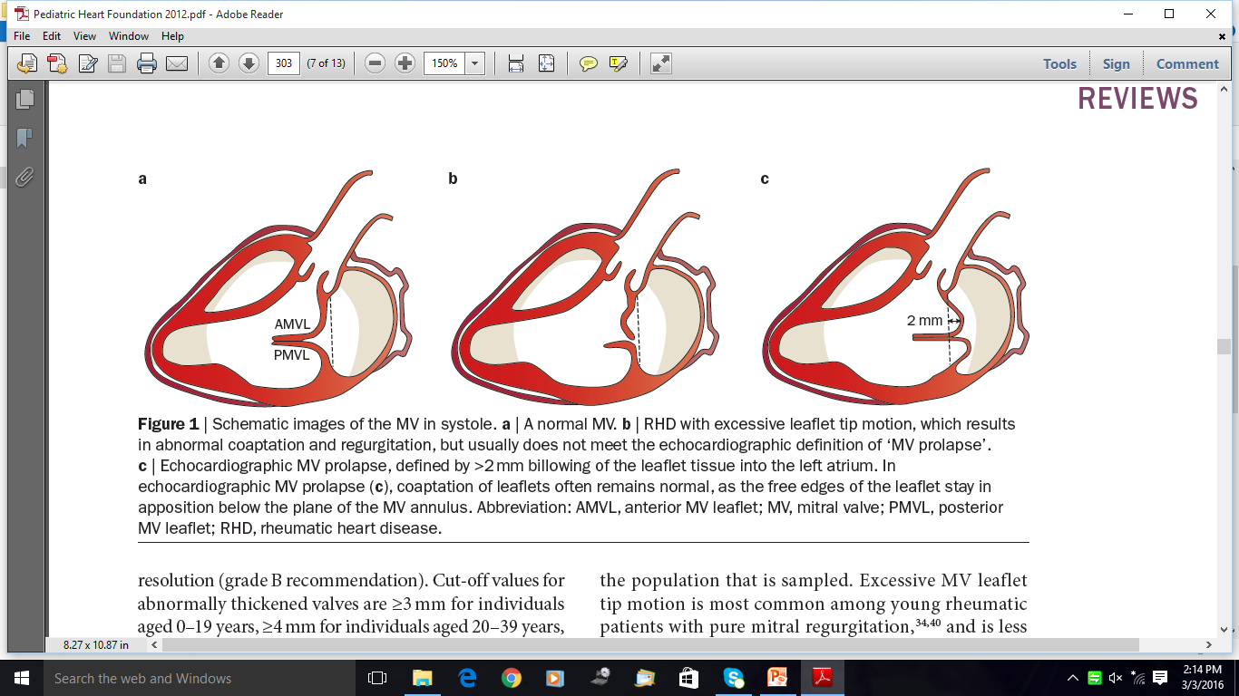

Slide 39
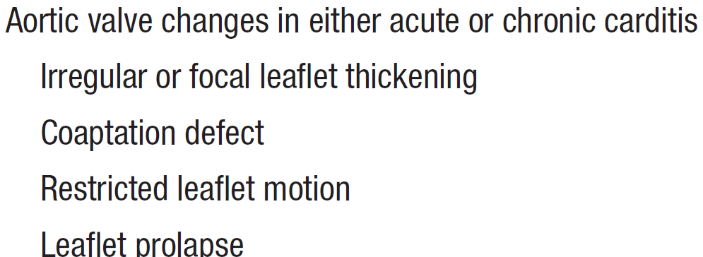

Slide 40
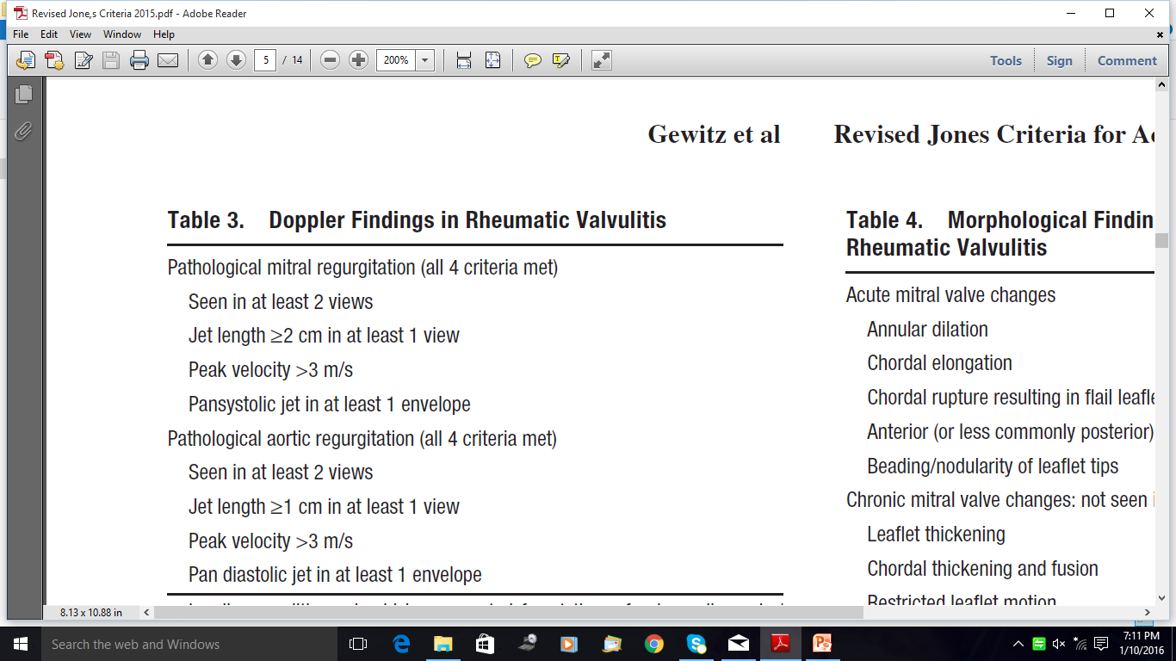

Slide 41
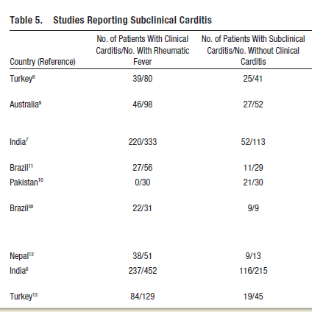

Slide 42
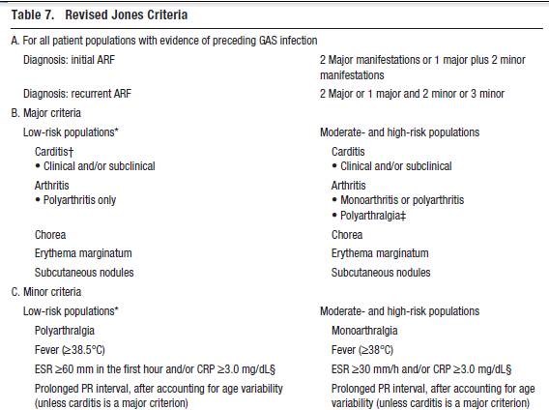
Notes:
*Low-risk populations are those with ARF incidence ≤2 per 100 000 school-aged children or all-age rheumatic heart
disease prevalence of ≤1 per 1000 population per year.
†Subclinical carditis indicates echocardiographic valvulitis as defined in Table 3.
‡See section on polyarthralgia, which should only be considered as a major manifestation in moderate- to high-risk
populations after exclusion of other causes. As in past versions of the criteria, erythema marginatum and subcutaneous
nodules are rarely “stand-alone” major criteria. Additionally, joint manifestations can only be considered in either the major
or minor categories but not both in the same patient.

Slide 43
A retrospective study in North Queensland, Australia,
investigated the impact of the addition of subclinical carditis, monoarthritis, and low-grade fever (>37.5°C) to the 1992 revised Jones criteria.
Of the 98 cases with a clinical diagnosis of ARF, only 71.4% met the revised Jones criteria.
Modification of the criteria, as discussed above, increased
the proportion of the cases that satisfied diagnostic criteria to 91.8%.
Of the 28 people who did not meet the traditional Jones criteria, 12 (42%) developed evidence of chronic RHD.
Addition of monoarthritis and subclinical carditis as major manifestations and low-grade fever as a minor manifestation to the Jones criteria could increase sensitivity when applied specifically to high-risk populations.
Additionally, study of the impact of the application of the New Zealand guidelines resulted in a 16% increase in the diagnosis of ARF compared with the 1992 revision of the Jones criteria.

Slide 44
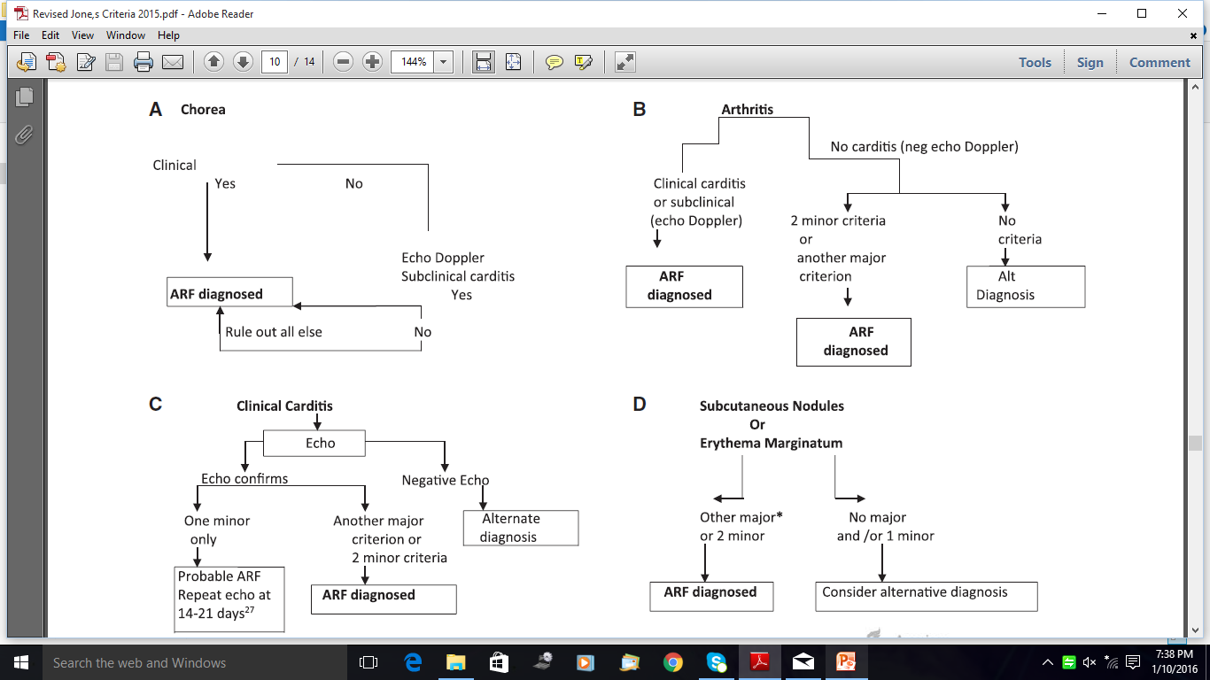

Slide 45
carditis

Slide 48
Indian Study on Rheumatic Fever
452 pts of Rheumatic Fever
  140 pts had clinical carditis
  213 patients without clinical carditis
213 pts without clinical carditis underwent echo Doppler
  MR jet in two planes, holo-systolic ,mosaic pattern
  AR jet in two planes, pan-diastolic, mosaic pattern
  Other added criteria in other studies: MR jet area>1 cm2, velocity >2.5/3.2 m/s, AR jet >1cm2, AR jet velocity >2.5m/s, AR jet width0.1 cm

Slide 49
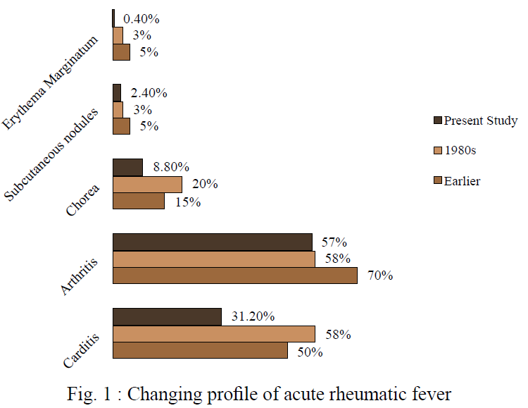
Vijayalaxmi : Medicine Update 2012

Slide 50
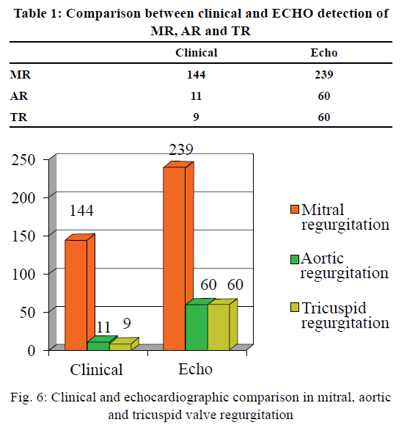

Slide 51
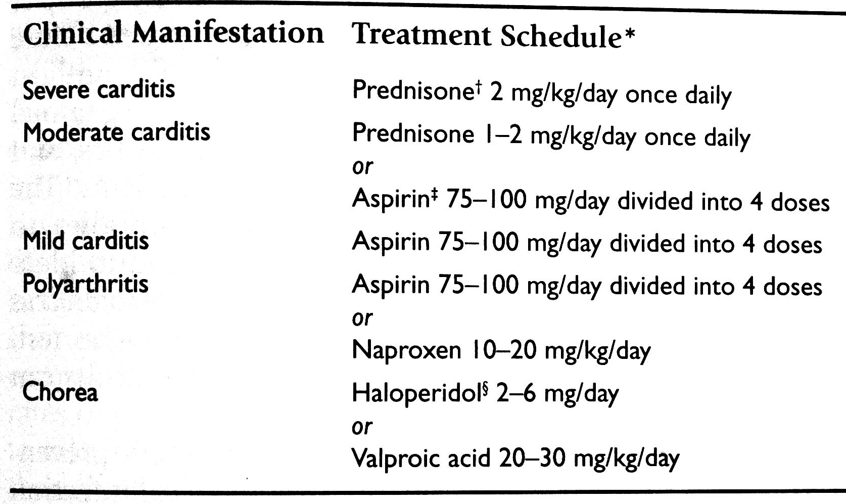
Management of Acute Rheumatic Fever

Slide 52
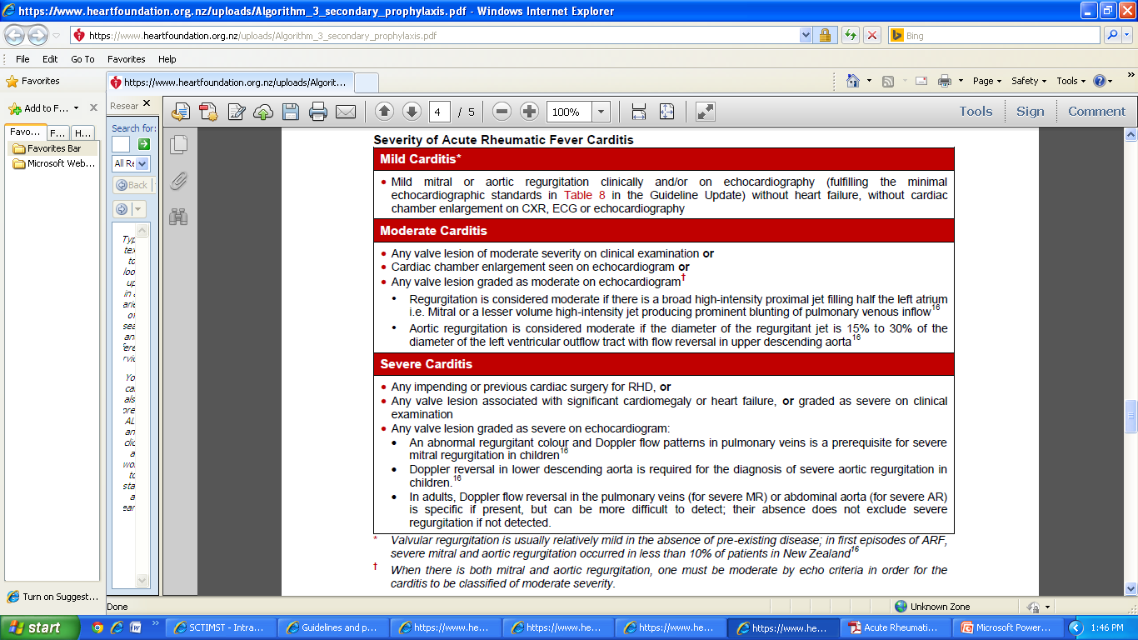
Notes:
Valvular regurgitation is usually relatively mild in the absence of pre-existing disease; in first episodes of ARF, severe mitral and aortic regurgitation occurred in less than 10% of patients in New Zealand16 Note 5
Individuals working or living with children, or in a living situation where there is overcrowding or close proximity to others (such as boarding schools, barracks and hostels), have a higher risk of exposure to GAS and subsequent development of ARF. In these cases, consideration should be given to extending the duration of prophylaxis.
† When there is both mitral and aortic regurgitation, one must be moderate by echo criteria in order for the carditis to be classified of moderate severity.
Tricuspid and pulmonary regurgitation graded mild or greater may be seen in people with normal hearts who have fever, volume overload or pulmonary hypertension. For this reason a diagnosis of carditis should not be based on right-side regurgitation alone. Although pulmonary and tricuspid regurgitation are often seen in association with left-sided lesions in ARF, pressure and volume overload must be excluded before attributing even moderate tricuspid regurgitation to valvulitis. If both left and right-sided lesions coexist in ARF carditis, then the predominant influence for diagnosis is the severity of the left-sided lesion.
Note 4
For those presenting with RHD for whom no initial episode of ARF can be identified, the decision to commence penicillin prophylaxis should be taken on an individual basis with regard to the age of the patient, severity of the disease, possible age of first attack and risk of exposure to GAS. See also page 46 in the Guideline Update.
It is recommended that cases with established valvular disease have regular dental care and follow the guidelines for endocarditis prophylaxis.
Note 5

Slide 53
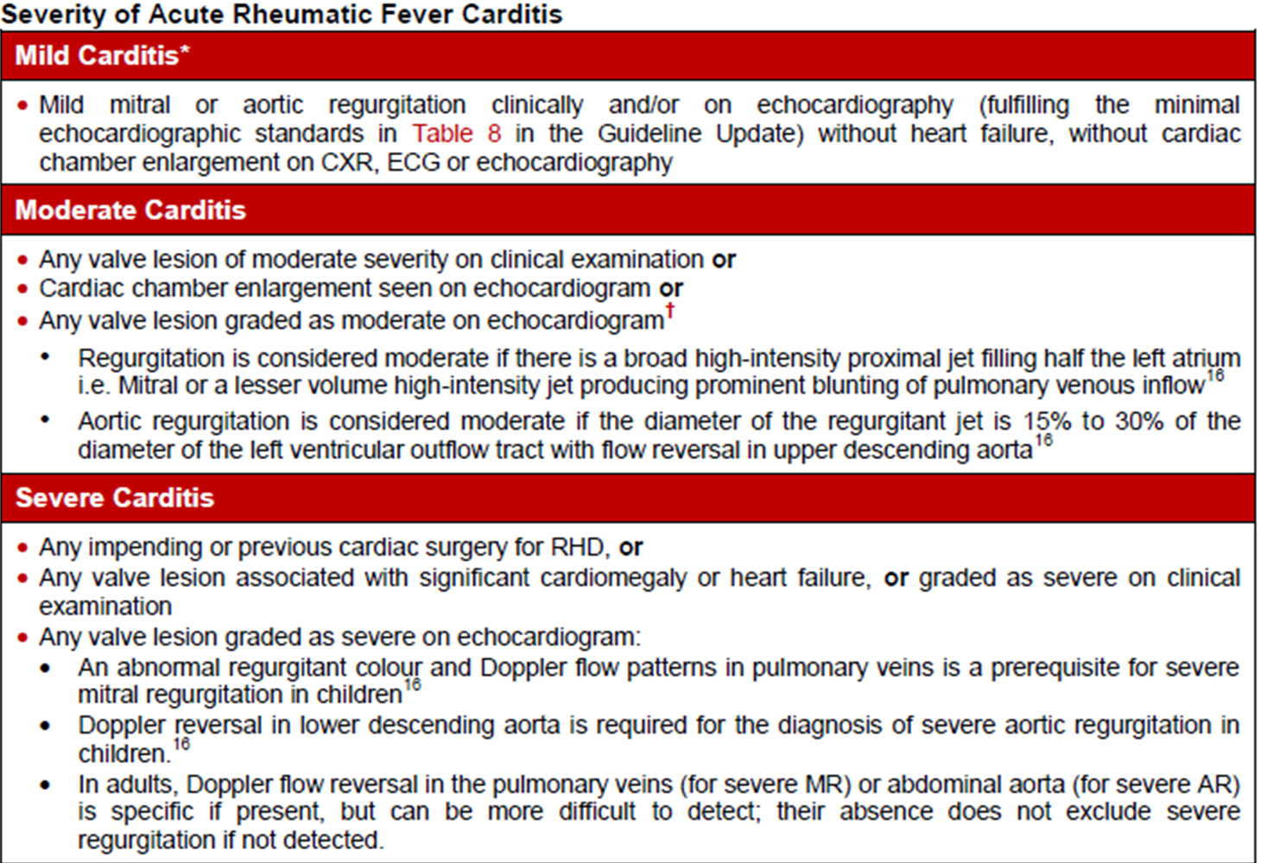

Slide 54
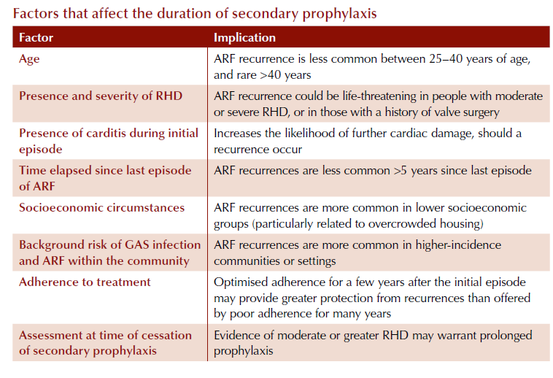

Slide 55
Rheumatic Fever: Secondary Prophylaxis
Factors to be considered:
Number of previous attacks
Time elapsed from the First attack
Risk of exposure to GABHS: Endemic areas
Age of the patient
Presence/ absence of cardiac involvement

Slide 56
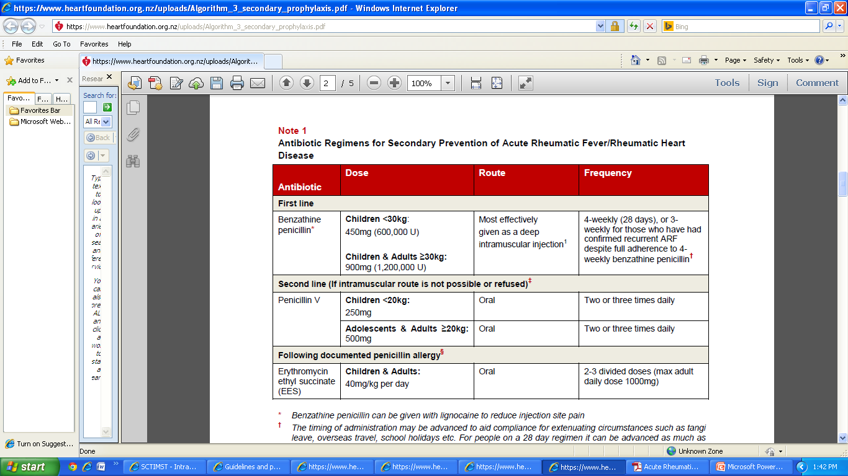
Notes:
The rates of allergic and anaphylactic reactions to 4 weekly benzathine penicillin are 3.2% and 0.2%, respectively, and fatal reactions are exceptionally rare.9,10 There is no increased risk with prolonged benzathine penicillin use.

Slide 57
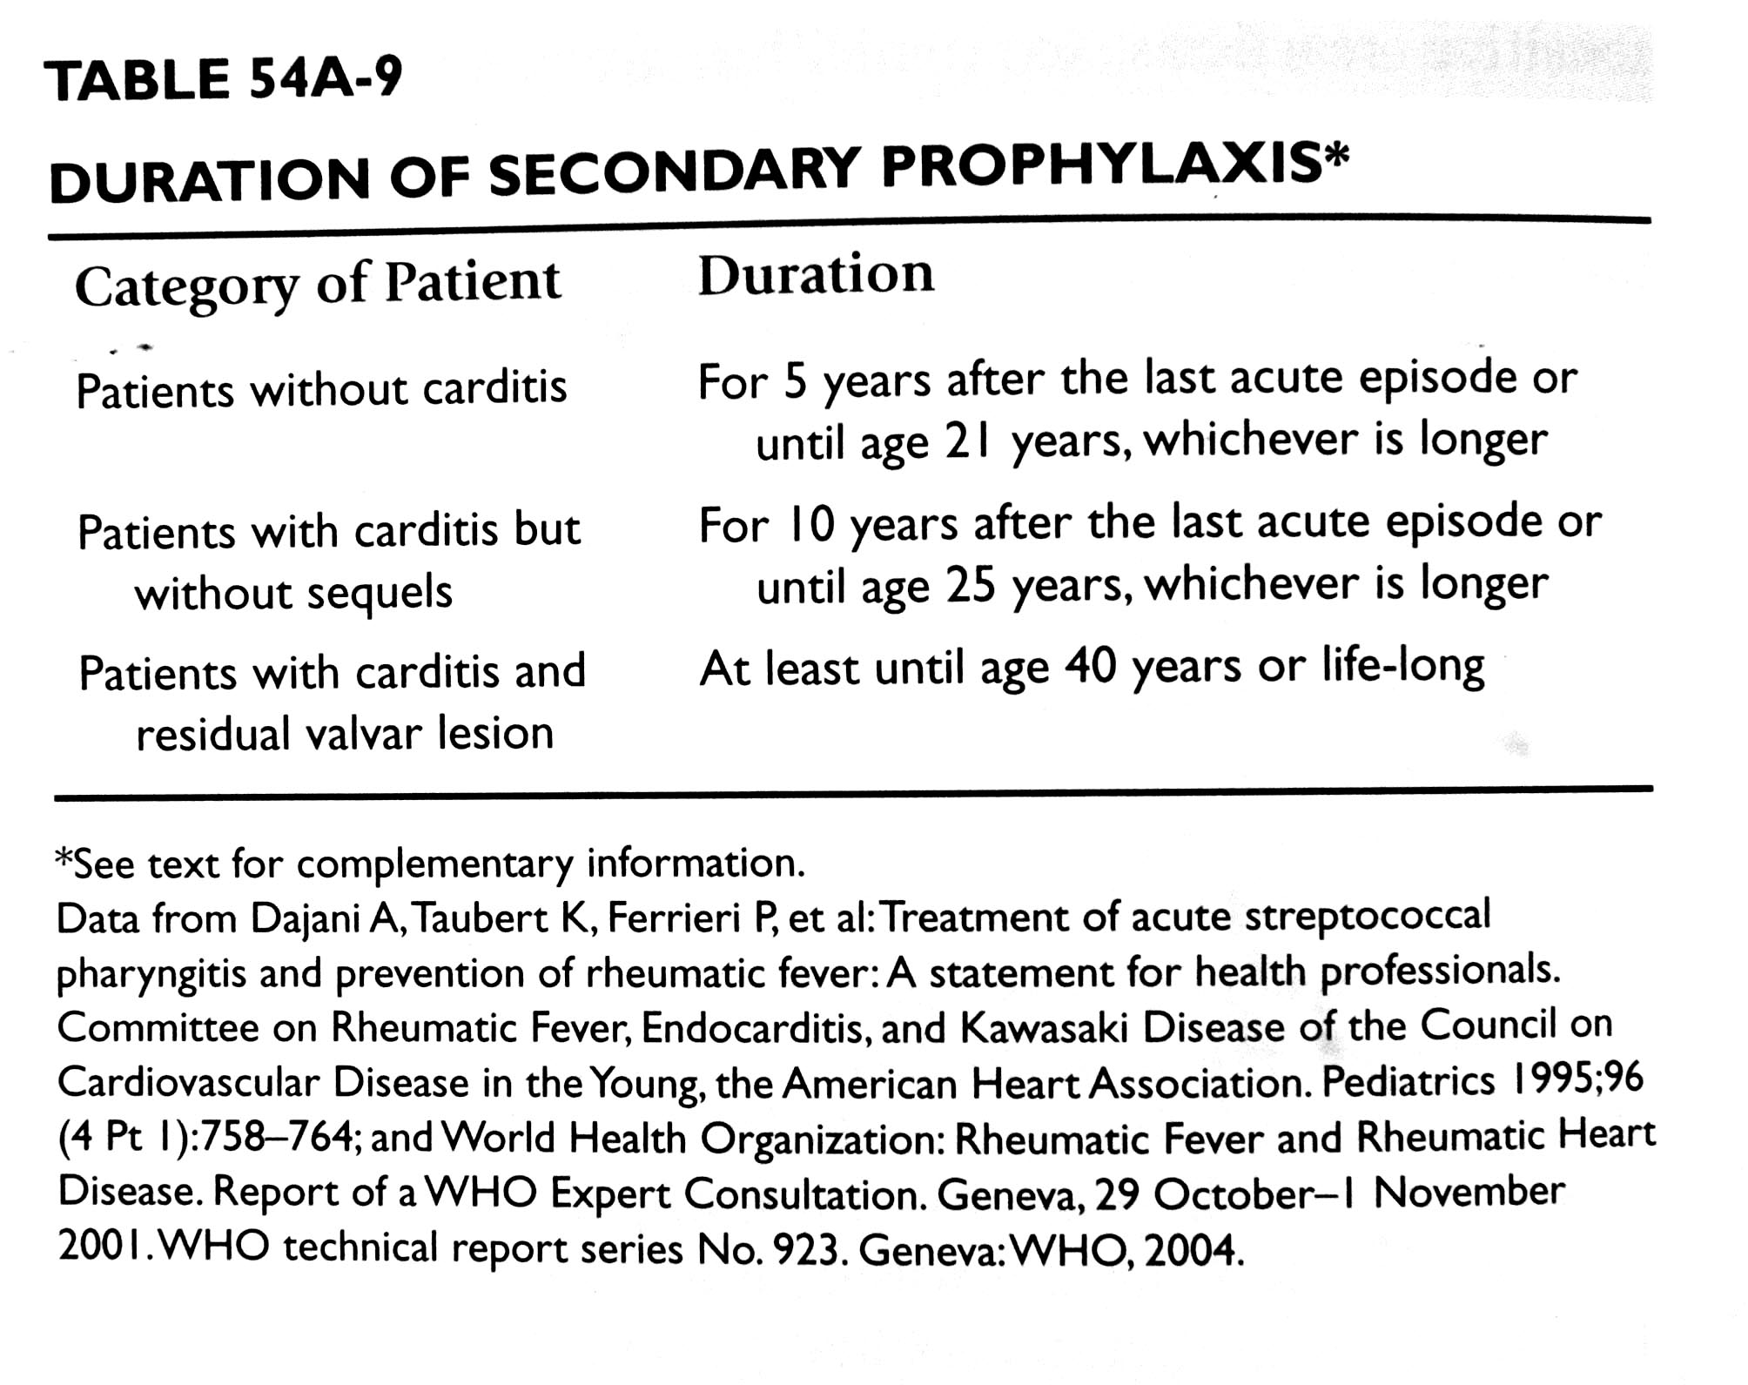

Slide 58
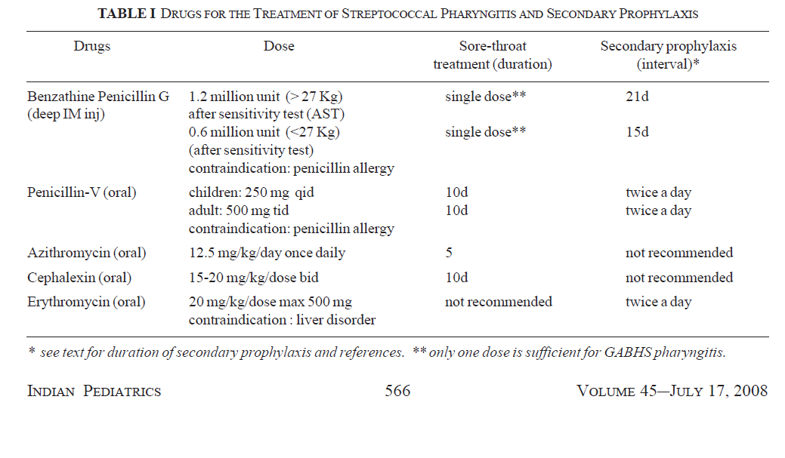

Slide 59
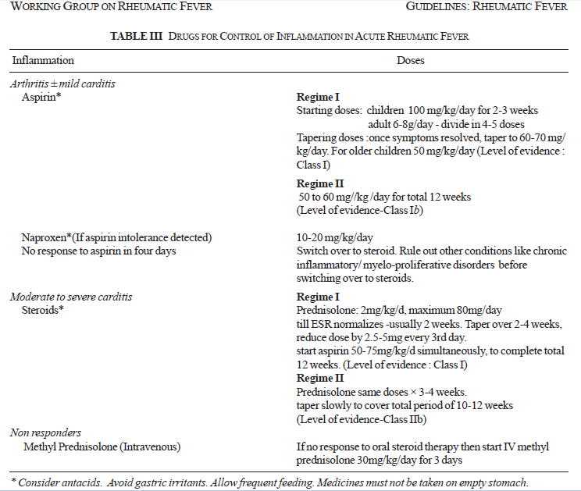

Slide 60
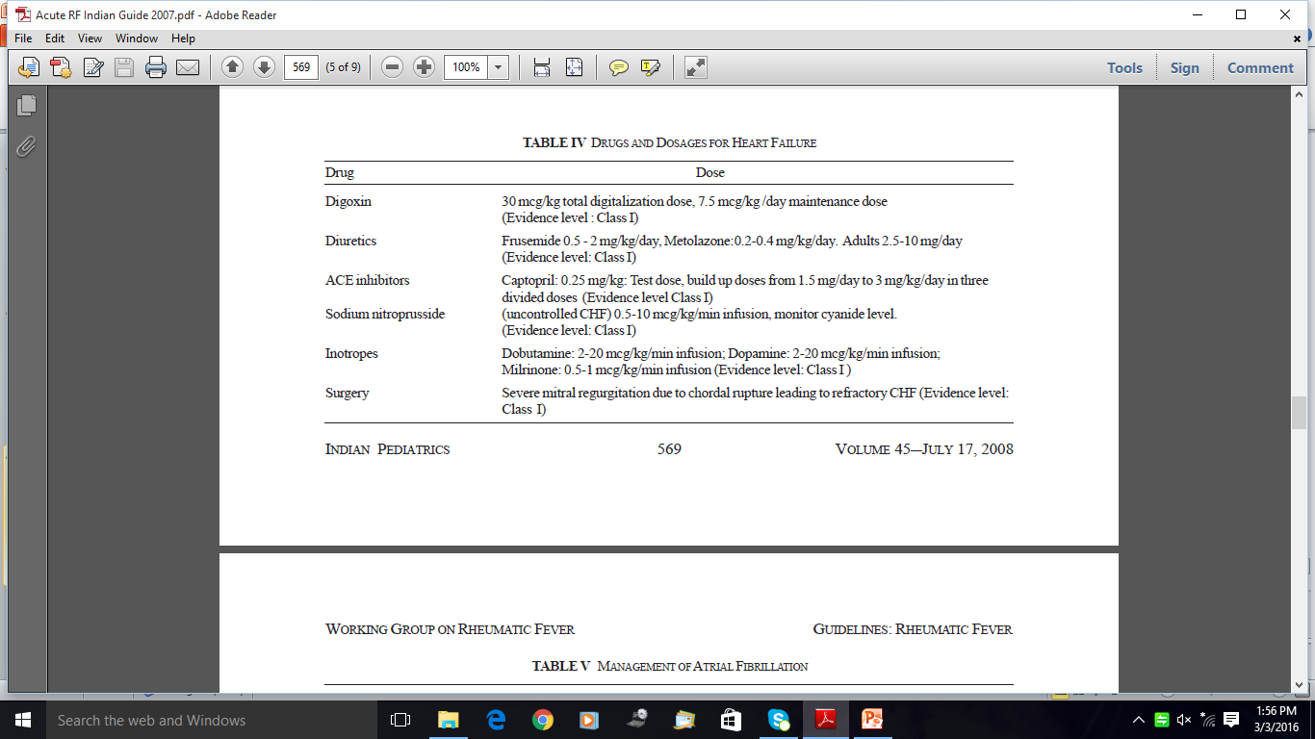

Slide 61
What do we do when abnormal Echo Doppler findings are picked up during screening/ health survey/ Epidemiological study: Guide lines
Definite RHD
Borderline RHD
  Why:
    In endemic areas, even in absence of past ARF, echo features of RHD call for secondary prophylaxis against rheumatic fever, as prevention of repeated attacks of ARF can protect the individual from severe / continuing valve damage and is cost effective

Slide 62
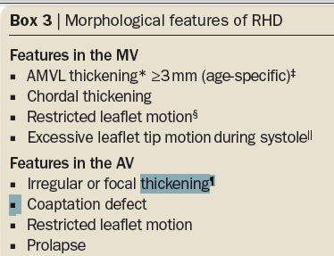

Slide 63
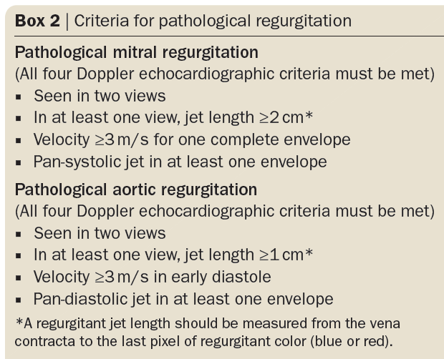

Slide 64
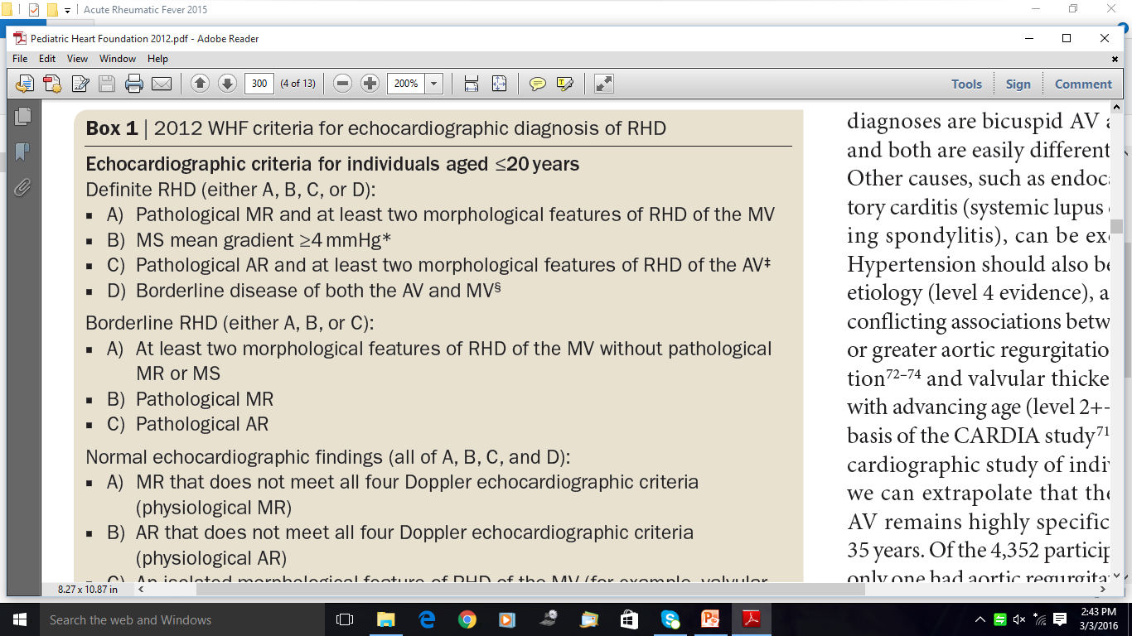

Slide 65
Anti Streptococcal Vaccines
For mass primary prophylaxis against GABHS
Target Antigen: M-Protein
  Type specific: N-Terminal region
    Protects against specific serotype
    Devoid of homology with human myocardial tissue
    Need polyvalent vaccine to cover all possible serological groups
  Carboxy terminal region( highly conserved): Protects against multiple serological groups
    Cross reaction with human tissue uncertain

Slide 66
Anti Streptococcal vaccines
Vaccine using Non M protein moieties
Streptococcal C5a peptidase( similar antigen in several serotypes)
  Low risk of cross reactivity with human tissue
  Protects against several M sero types
Streptococcal extra cellular protease vaccine using strep. Pyrogenic exotoxin

Slide 67
Thank You

Slide 68
Aschoff Bodies
Pathognomonic of RF
Perivacular granulamatous lesion less than 1 mm size
  Central area of necrosis surrounded by histiocytes variably described as Anitschkow cells/ Aschoff cells with basophilic cytoplasm with a clear vesicular nucleus with chromatin condensation: (mesenchymal origin)
    Transverse section: Owl’s eye
    Longitudinal sectioon: caterpillar
Evolves over a period of time from 2 weeks of of onset of carditis as exudative phase followed by the granulomatous stage lasting 1 to 6 months and may persist as fibrotic stage for variable duration
Not a useful marker of active carditis

Slide 69
ARF: Endocarditis
Most frequent and clinically significant complication
Valves show small 1-2 mm fibrinous verrucuos vegetations on atrial surface of MV & ventricular surface of aortic valve
Leads to chronic rheumatic valvulitis with fibrotic thickening and fusion of valve leaflets
Typically leads to valve dysfunction and MR .

Slide 70
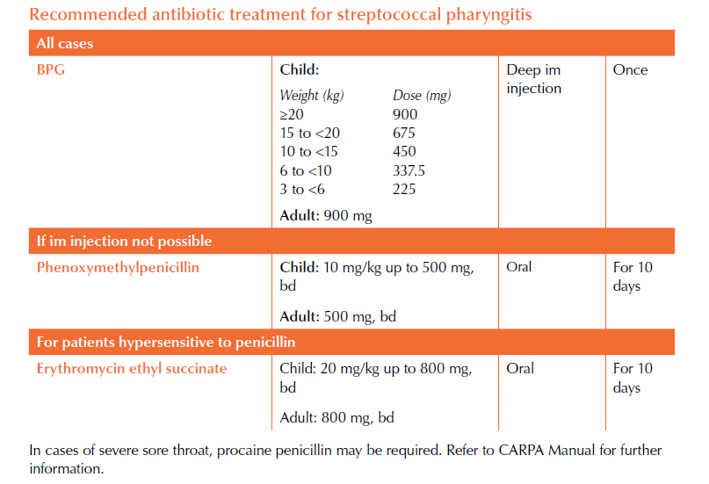

Slide 71
Anti Streptococcal vaccines
Vaccine using Non M protein moieties
Streptococcal C5a peptidase( similar antigen in several serotypes)
  Low risk of cross reactivity with human tissue
  Protects against several M sero types
Streptococcal extra cellular protease vaccine using strep. Pyrogenic exotoxin

Slide 74
Notes:
Valvular regurgitation is usually relatively mild in the absence of pre-existing disease; in first episodes of ARF, severe mitral and aortic regurgitation occurred in less than 10% of patients in New Zealand16 Note 5
Individuals working or living with children, or in a living situation where there is overcrowding or close proximity to others (such as boarding schools, barracks and hostels), have a higher risk of exposure to GAS and subsequent development of ARF. In these cases, consideration should be given to extending the duration of prophylaxis.
† When there is both mitral and aortic regurgitation, one must be moderate by echo criteria in order for the carditis to be classified of moderate severity.
Tricuspid and pulmonary regurgitation graded mild or greater may be seen in people with normal hearts who have fever, volume overload or pulmonary hypertension. For this reason a diagnosis of carditis should not be based on right-side regurgitation alone. Although pulmonary and tricuspid regurgitation are often seen in association with left-sided lesions in ARF, pressure and volume overload must be excluded before attributing even moderate tricuspid regurgitation to valvulitis. If both left and right-sided lesions coexist in ARF carditis, then the predominant influence for diagnosis is the severity of the left-sided lesion.
Note 4
For those presenting with RHD for whom no initial episode of ARF can be identified, the decision to commence penicillin prophylaxis should be taken on an individual basis with regard to the age of the patient, severity of the disease, possible age of first attack and risk of exposure to GAS. See also page 46 in the Guideline Update.
It is recommended that cases with established valvular disease have regular dental care and follow the guidelines for endocarditis prophylaxis.
Note 5

Slide 75
Echo features of Valvulitis: MV
Annular dilatation
Chordal elongation
AML prolapse only of the coapting portion of leaflet
Posteriorly directed Mitral incompetence jet with Mac Callum’s patch
Focal nodular thickening of leaflet margins: verrucous vegetations

Slide 76
Doppler Features of MR/ AR
Posteriorly directed jet
Holosystolic
Mosaic pattern
At least 3 cm depth
Two orthogonal views

Slide 77
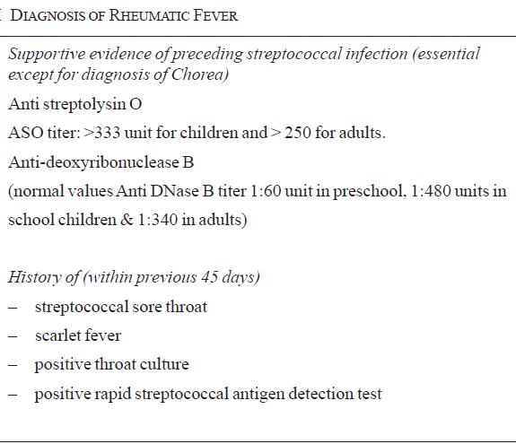

Slide 78
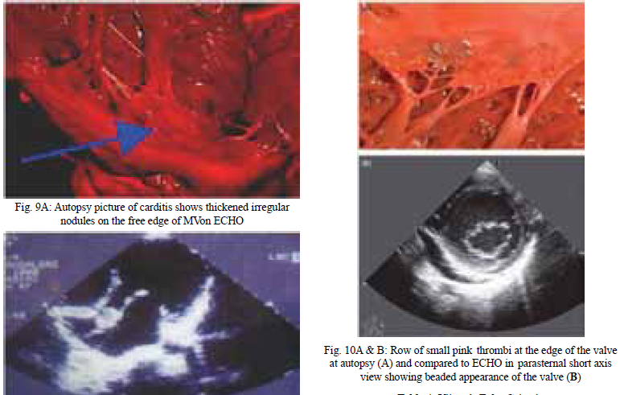

Slide 79

Streptococcus Pyogenes

